Slide 1
Telecommunication Customer Churn Prediction
Analyzing Customer Retention with Machine Learning

Slide 2
Agenda
Project & Dataset Overview
Exploratory Data Analysis
Machine Learning Model Selection
Model Performance & Results
Deployment Using Streamlit
Challenges Faced & Solutions
Key Factors Driving Customer Churn
Next Steps & Action Items
Conclusion

Slide 3
Project Overview
Objective: Predict customer churn for a telecom company.
Techniques Used: Machine Learning for classification & Prediction.
Deployment: Interactive prediction using Streamlit.

Slide 4
Dataset Overview
Source: Telecommunication customer data.
Total Records: 5000 rows
Features Overview:
Demographics: States, Area Code.
Services: PhoneService, MultipleLines, InternetService, Streaming.
Account Information: Contract Type, Payment Method, Monthly Charges, Total Charges.
Target Variable: Churn (Yes/No).

Slide 5
Exploratory Data Analysis (EDA)
Data Cleaning: Missing value handling, outlier detection.
Key Insights:
Distribution of churn vs. non-churn customers.
Correlation between features.
Boxplots for numerical variables.
Visualizations: Correlation Matrix, Histogram, Pie Chart, Choropleth.

Slide 6
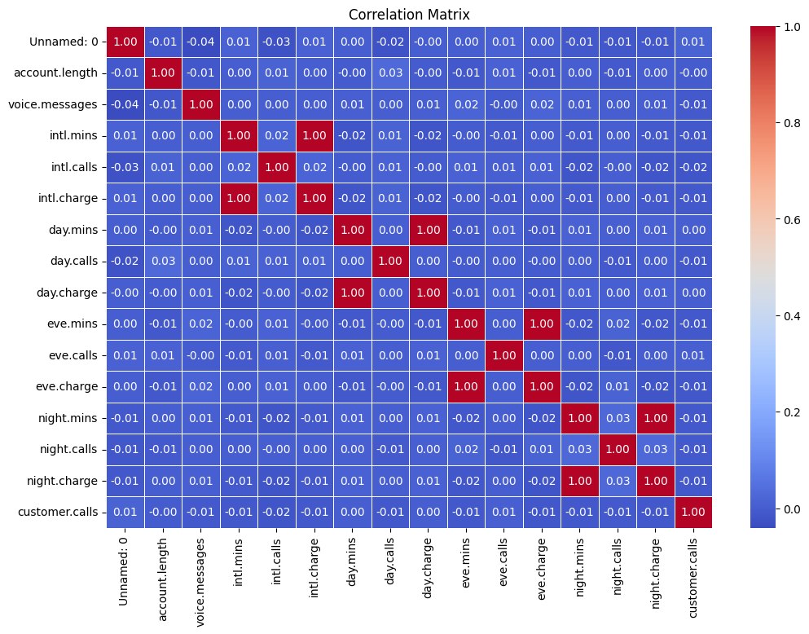
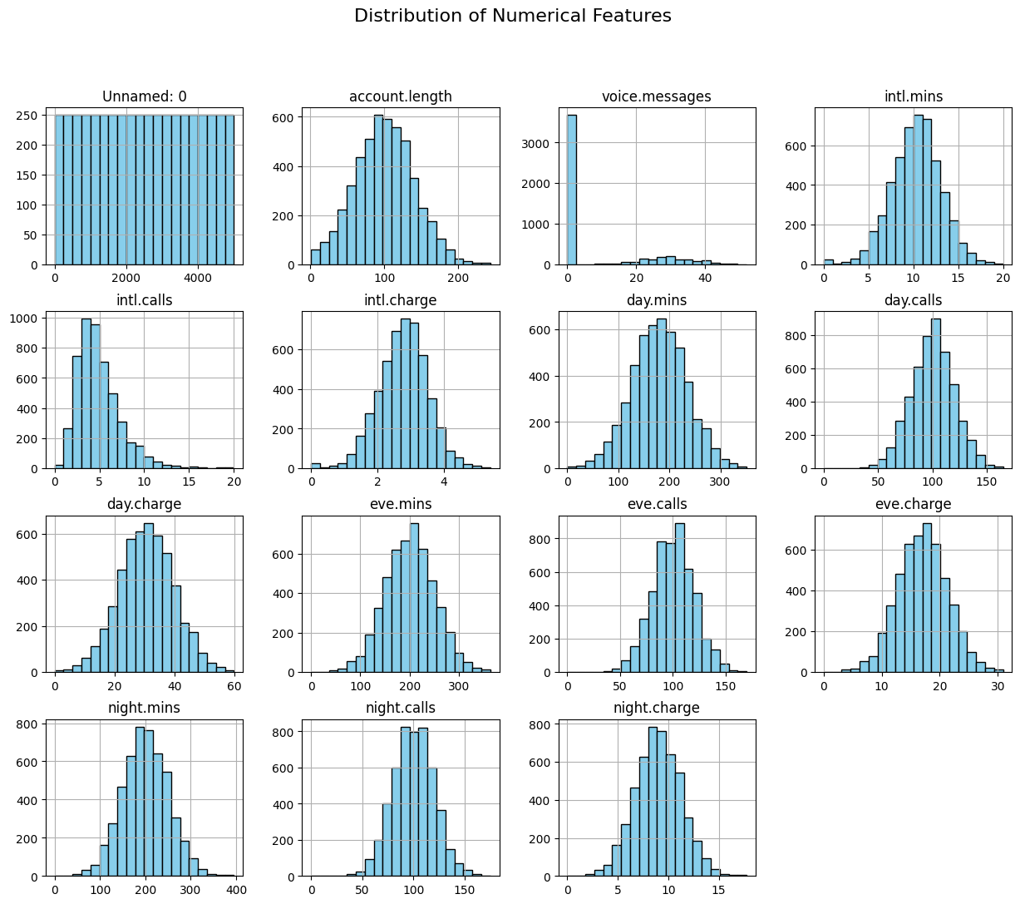
Visualizations
Correlation Matrix
Histogram

Slide 7
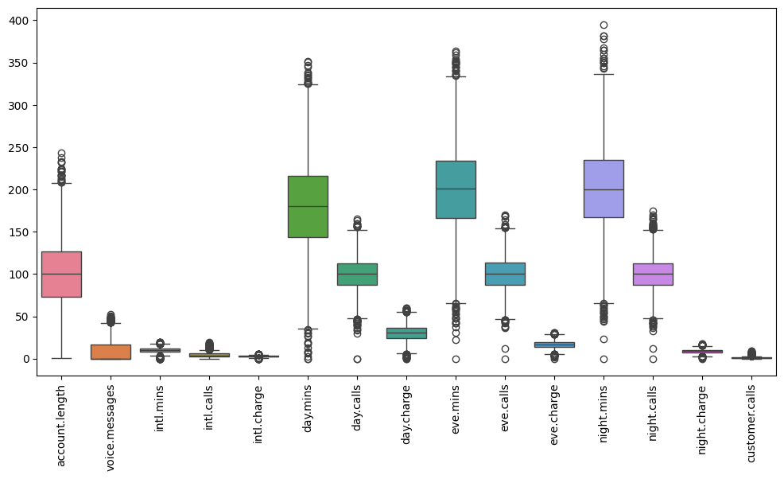
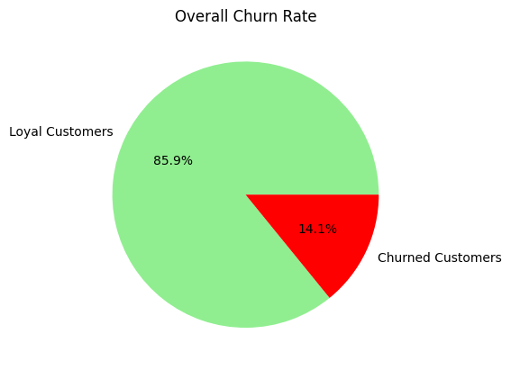
Visualizations
Boxplot
Pie Chart

Slide 8
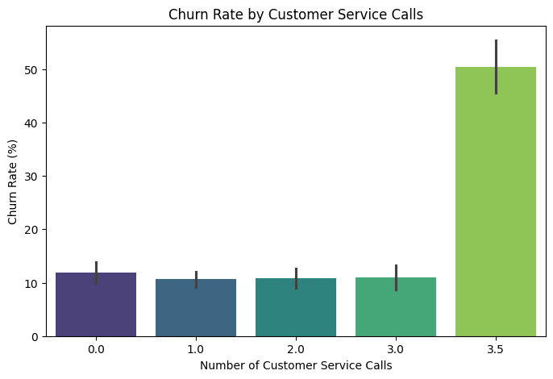
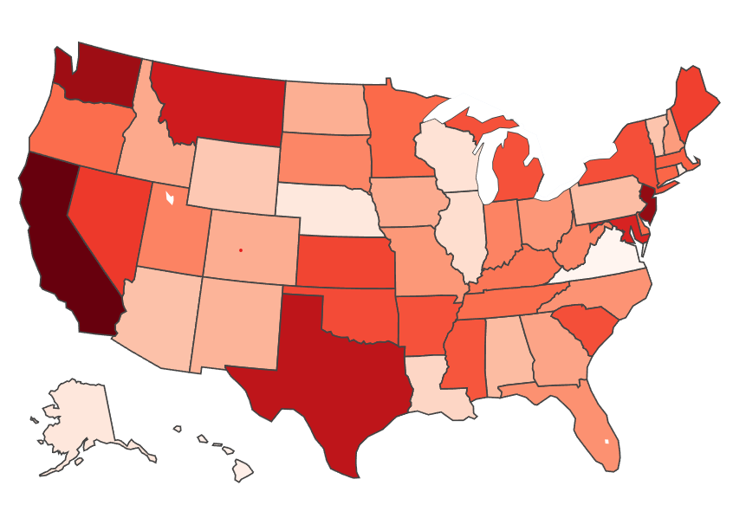
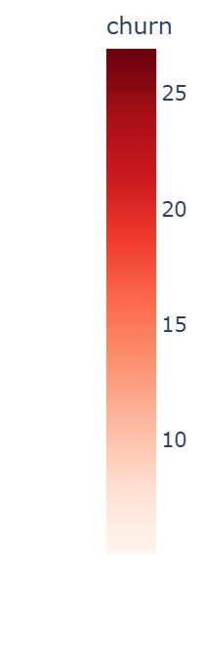
Visualizations
Choropleth

Slide 9
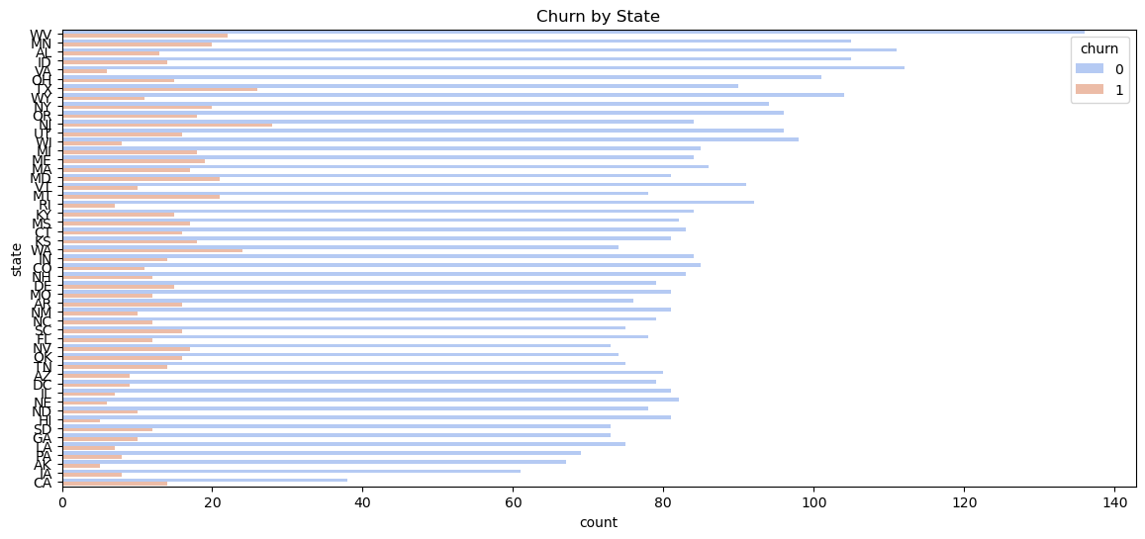
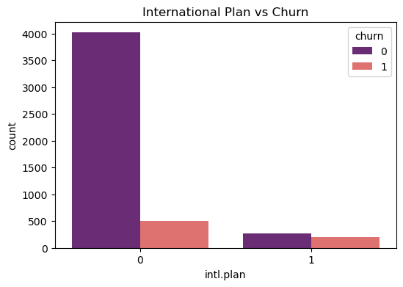
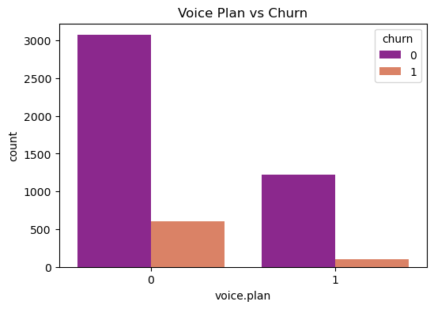
Visualizations

Slide 10
Machine Learning Model Selection
Preprocessing:
Encoding categorical variables.
Feature scaling.
Train-Test split.
Models Evaluated:
Logistic Regression
Decision Tree
Random Forest
XGBoost
Performance Metrics: Accuracy, Precision, Recall, F1-score, ROC-AUC.

Slide 11
Model Performance & Results
Best Performing Model:
Model | Accuracy (Test) | F1 Score (Test) | Recall (Test) | Precision (Test) | ROC AUC (Test)
Logistic Regression | 0.8760 | 0.8425 | 0.8760 | 0.7143 | 0.5841
Decision Tree | 0.9260 | 0.9269 | 0.9260 | 0.7211 | 0.8575
Random Forest | 0.9660 | 0.9649 | 0.9660 | 0.9412 | 0.8988
XGBoost | 0.9680 | 0.9669 | 0.9680 | 0.9496 | 0.9030

Slide 12
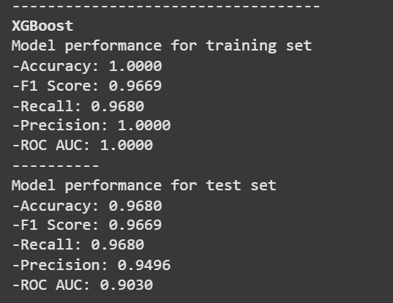
Model Performance & Results
Evaluation Metric Report for the XGBoost Model

Slide 13
Deployment Using Streamlit
User Interface: Upload customer data and predict churn probability.
Process: Load model, take input, display prediction.

Slide 14
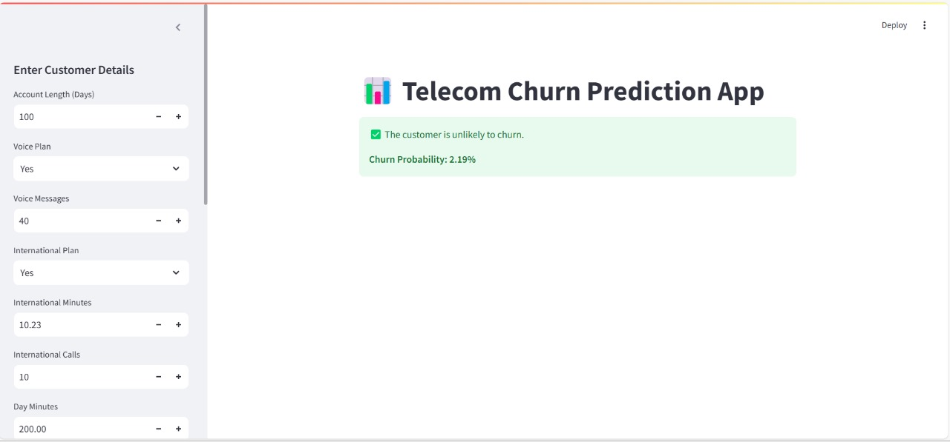
Screenshots of Streamlit Application

Slide 15
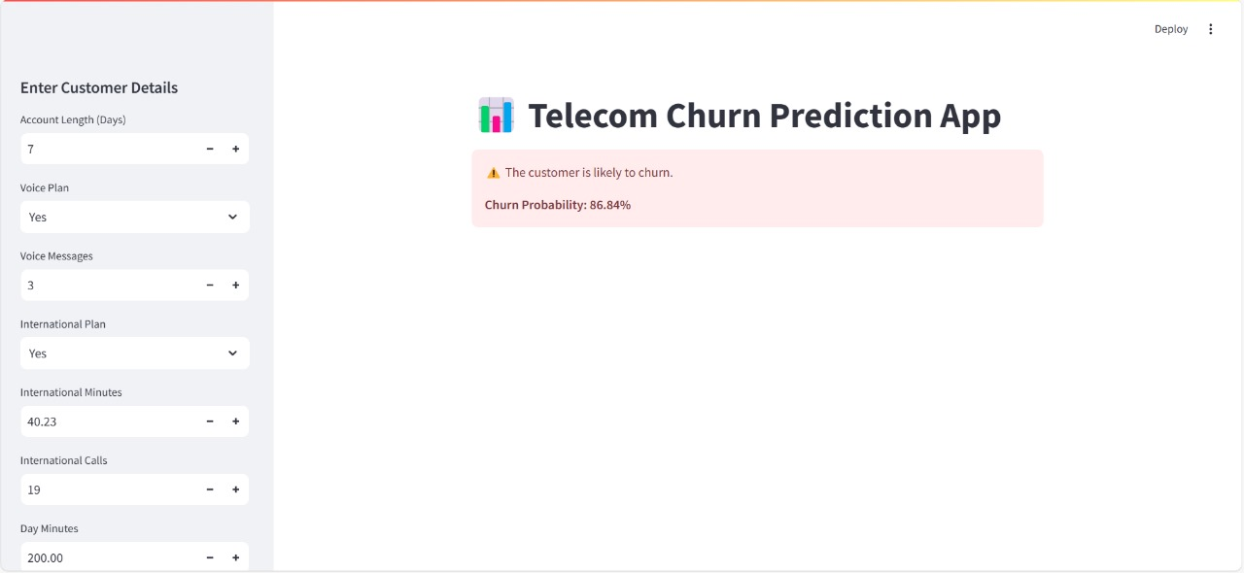
Screenshots of Streamlit Application

Slide 16
Challenges Faced & Solutions
Handling and Cleaning Data – Managing missing values, removing duplicates, and dealing with inconsistent or unwanted data to ensure dataset quality.
Extracting Meaningful Insights – Identifying key patterns and relationships within the data to improve model performance and decision-making.
Effective Data Visualization – Choosing the right plots and techniques to represent data clearly, making it easier to interpret trends and findings.

Slide 17
Key Factors Driving Customer Churn
Customer Service call > 3
Call Charges & Usage
Low Voice Message Usage
Plane based on Geographical area

Slide 18
Next Steps & Action Items
Hyper parameter tuning to enhance model performance.
Deploy as an API for real-time integration with telecom databases.
Improve UI/UX for better customer insights.

Slide 19
Conclusion
Effective data handling: Successfully managed missing and unwanted data to ensure accurate analysis.
Model performance: Used XGBoost, achieving high accuracy and strong evaluation metrics.
Insights for business strategy: Helps telecom companies optimize pricing, offer personalized plans, and improve customer engagement to reduce churn.
Key churn factors identified: Call Charges and Usage, low usage of voice messages, and Customer Service calls.

